Slide 1
MST and Prim’s Algorithm
Jonas Buro
June 2023
CSC 226 UVIC

Slide 2
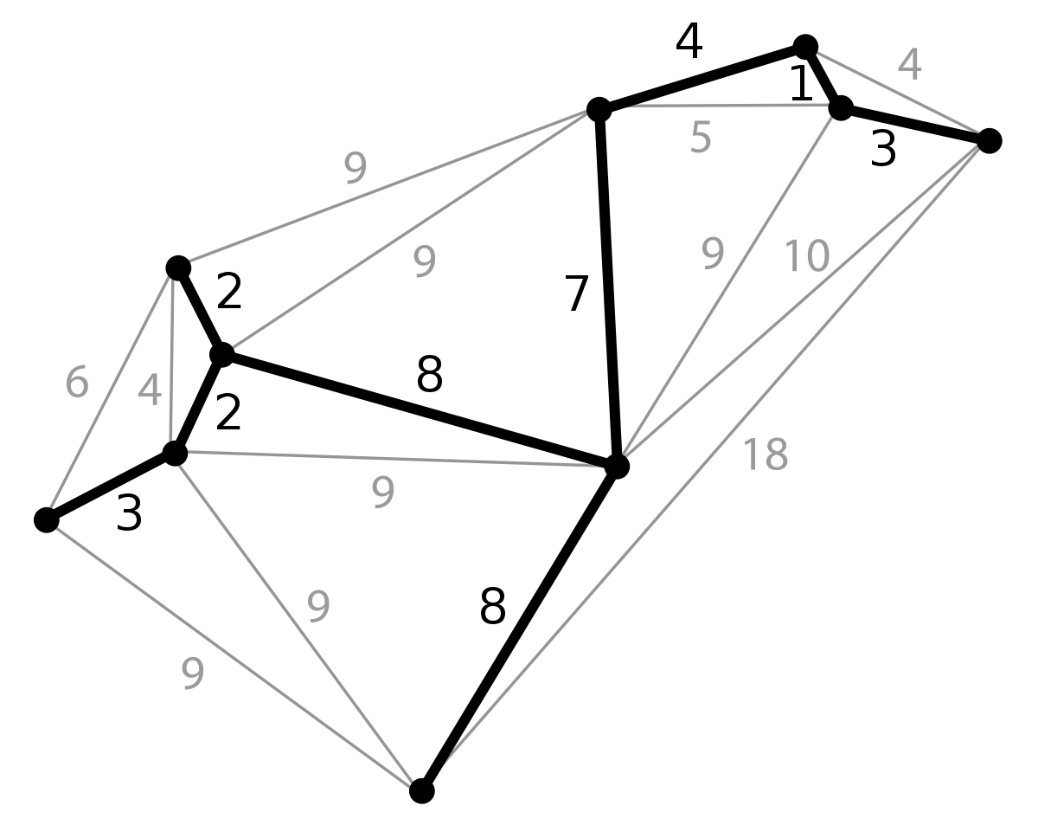
Minimum Spanning Tree Definition
The MST of a connected edge-weighted graph G is a spanning tree whose sum of weights is the smallest possible.
image source Wikipedia
Notes:
11

Slide 3
Minimum Spanning Tree Problem
Cayley: There are n^n-2 spanning trees on a complete n-graph
Brute force not feasible
Notes:
11

Slide 4
Cut and Cycle Properties
Cycle Property: For any cycle C in a connected graph G, the heaviest edge in C does not appear in the minimum spanning tree
Cut Property: For any proper non-empty subset X of the vertices, the lightest edge with exactly one endpoint in X belongs to the minimum spanning tree
Proofs via contradiction
Notes:
11

Slide 5
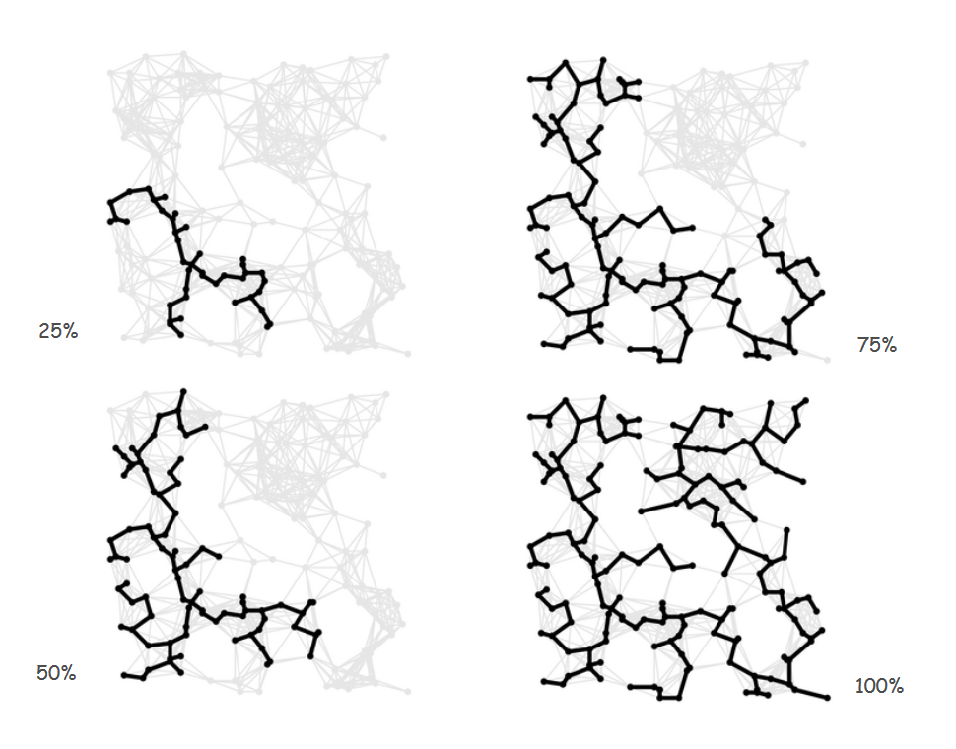
Prim’s Algorithm
Intuition: Grow the MST
image source Princeton CS Department
Notes:
11

Slide 6
Prim’s Algorithm
Pseudocode:
For a graph G(V,E)
Initialize T as arbitrary vertex v of V
While |T| != |V-1|
Add lowest weight edge e to T, where e has one endpoint
Notes:
11

Slide 7
Proof of Correctness
Theorem: Prim’s algorithm computes MST of connected graph .
Proof sketch: Let T be the MST we are growing
Before adding any edge e to T in Prim’s algorithm, consider the two sets T and V \ T.
Any edge e we add will have one endpoint in T, one endpoint in V \ T.
By the Cut Property, the minimum weight edge e must be in the MST.
Notes:
11

Slide 8
Run Time Analysis
How do we find the cheapest edge when adding?
Brute force (check all edges): O(E) per edge added
Total of O(VE)
Notes:
11

Slide 9
Run Time Analysis
How do we find the cheapest edge when adding?
Use a PQ to keep track of cross-edges incident to your growing tree
O(log E) per edge added – why? binary heap insert/delete-min
Total of O(E log E) - (in this implementation)
Notes:
11

Slide 10
Lazy vs. Eager paradigm
Distinction of when to load/validate/… objects
Lazy: only when the data is needed
Eager: as soon as possible
In the context of this lab, the ‘cross-edge’ property of the edges on the PQ might change as we grow the MST. We will lazily evaluate edges taken from the PQ to ensure they are in fact cross-edges.
Notes:
<number>

Slide 11
Codebase
Lazy Prim’s skeleton code
Download the required .jar (Java Archive) into project directory
Configure your library references/classpath
Main: entry point – CLI args should be path to test_file.txt containing graph you want to test
TODO: complete method implementations
Remember: separate solving from implementation!
Notes:
<number>

